Slide 1

Agile Methodology
Khader Sawaftah, Product Owner at ASAL Technology. Certified in:
PMP®
PMI-ACP®
PSPO1™

Slide 2


Slide 3
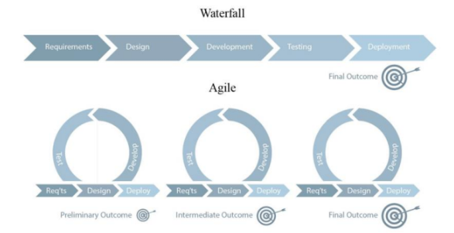
Project Management Methodologies

Slide 4
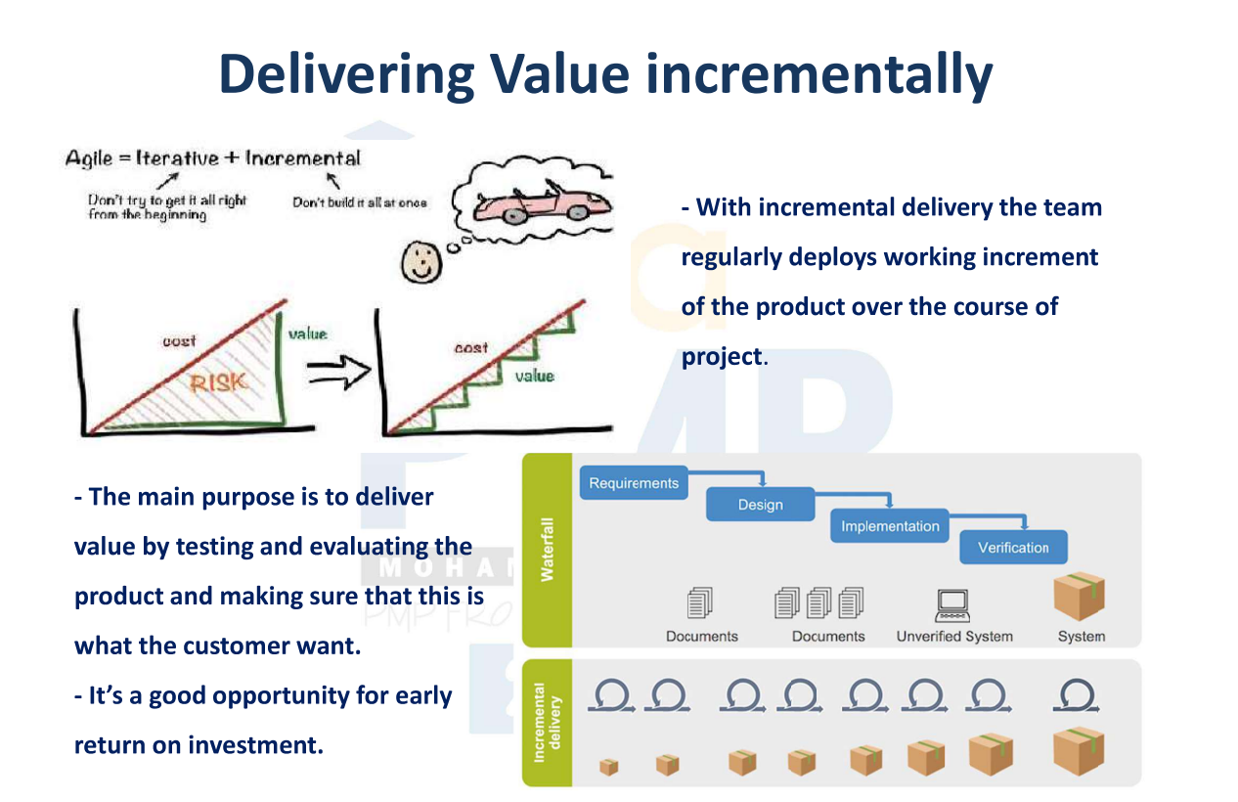
Why Scrum ?
Scrum promoting collaboration, flexibility, and customer-centricity.

Slide 5
Scrum has three key roles
Product Owner: Represents the stakeholders, prioritizes and manages the product backlog.
Scrum Master: Facilitates the Scrum process, ensures adherence to Scrum principles.
Development Team: Self-organizing and cross-functional team responsible for delivering the product.

Slide 6
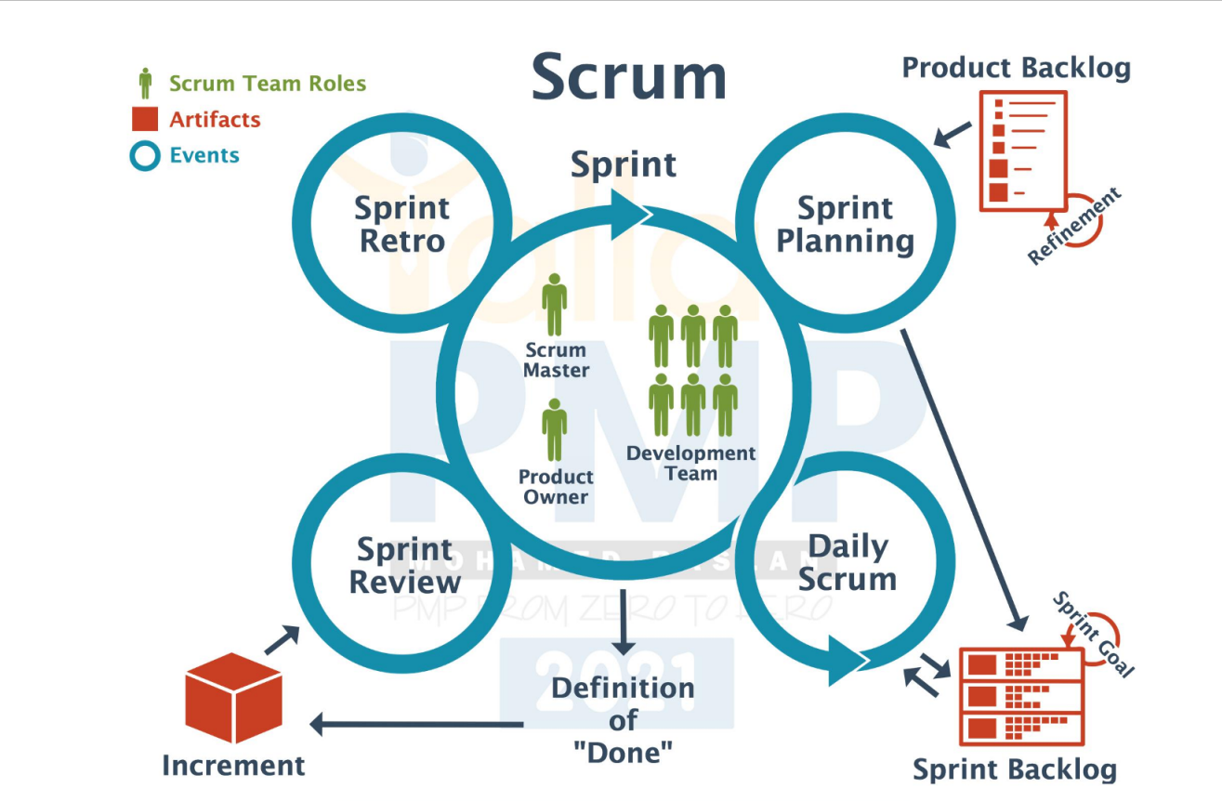
Scrum-Artifacts and Events

Slide 7


Slide 8
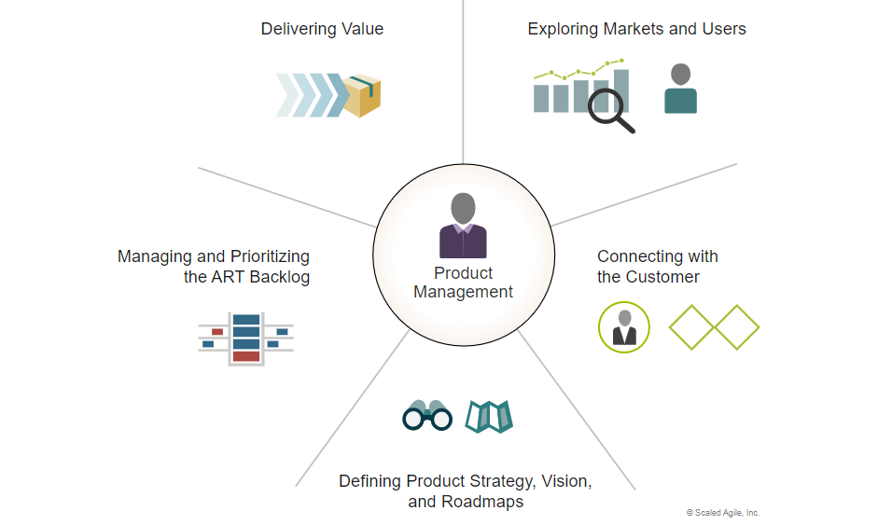
What is Product Management

Slide 9
Agile tools
Jira
Asana
Aha
infinity

Slide 10
How Can I enrich my knowledge in Product management
YouTube : https://www.youtube.com/watch?v=lF70OuNWdrM
Books : PMPOK GUIDE
Podcasts : This is Product Management, Product to Product
Online Courses : PMP, PSPO
Blogs and Websites: Mind the Product

